Slide 1
FOCUS LENS
OPTIMIZATION

Slide 2
CONSTRUCTION
OF LENS PROBLEM

Slide 3
CONSTRUCTION
OF LENS PROBLEM

Slide 4
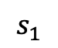
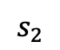
d
$$s_{2}$$
$$s_{1}$$
CONSTRUCTION
OF LENS PROBLEM

Slide 5
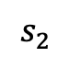
d
$$s_{2}$$
$$s_{1}$$
CONSTRUCTION
OF LENS PROBLEM

Slide 6
DIFFERENTIAL EVOLUTION
GLOBAL OPTIMIZATION

Slide 7
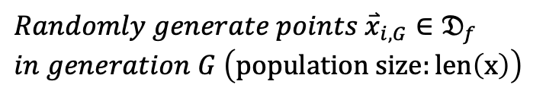
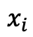
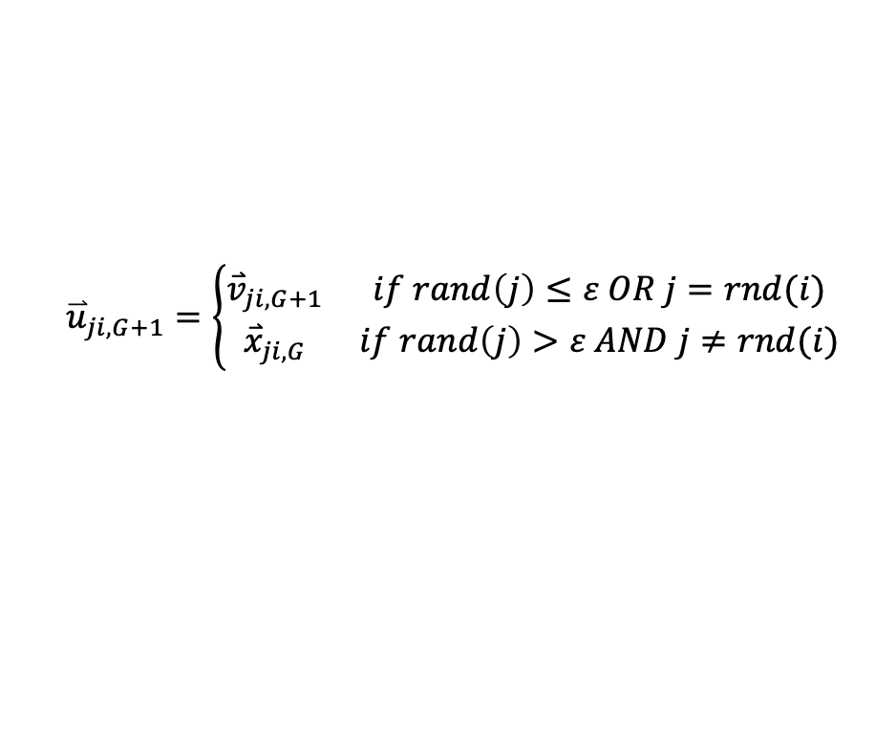
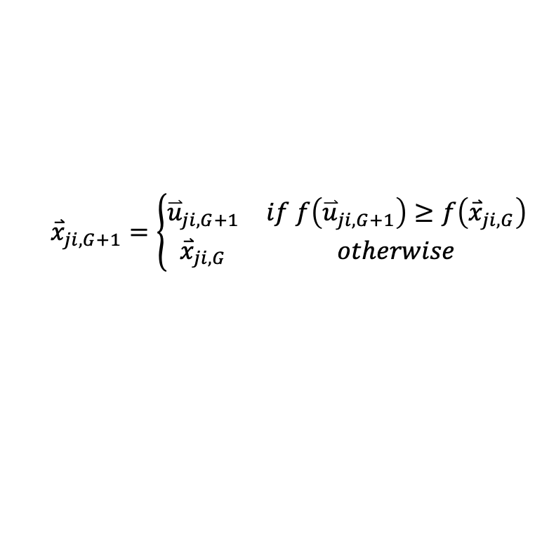
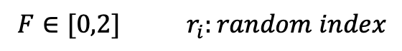
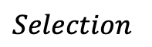
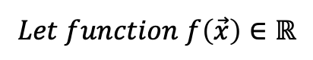

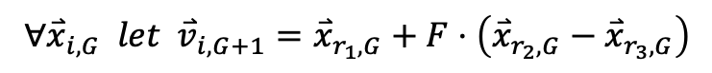
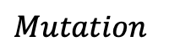
$$Let function f\left(\vec{x}\right)∈ℝ$$
$$Randomly generate points {\overset{⃑}{x}}_{i,G}∈𝔇_{f}$$
$$in generation G \left(population size:len\left(x\right)\right)$$
$$Mutation$$
$$∀{\overset{⃑}{x}}_{i,G} let {\overset{⃑}{v}}_{i,G+1}={\overset{⃑}{x}}_{r_{1},G}+F⋅\left({\overset{⃑}{x}}_{r_{2},G}−{\overset{⃑}{x}}_{r_{3},G}\right)$$
$$F∈[0,2] r_{i}:random index$$
$$Crossover$$
$$x_{i}$$
$${\overset{⃑}{u}}_{ji,G+1}=\left\{\begin{matrix}{\overset{⃑}{v}}_{ji,G+1} & if rand\left(j\right)≤ε OR j=rnd(i) \\ {\overset{⃑}{x}}_{ji,G} & if rand\left(j\right)>ε AND j≠rnd(i)\end{matrix}\right.$$
$$Selection$$
$${\overset{⃑}{x}}_{ji,G+1}=\left\{\begin{matrix}{\overset{⃑}{u}}_{ji,G+1} & if f\left({\overset{⃑}{u}}_{ji,G+1}\right)≥f\left({\overset{⃑}{x}}_{ji,G}\right) \\ {\overset{⃑}{x}}_{ji,G} & otherwise\end{matrix}\right.$$
DIFFERENTIAL EVOLUTION
GLOBAL OPTIMIZATION
https://link.springer.com/content/pdf/10.1023/A:1008202821328.pdf

Slide 8
RESUTLS
GLOBAL OPTIMIZATION

Slide 9
NOTES
In smooth lens, the further the smaller the width
Rougher Lens, exponentially wider focal width with distance
Multiple minima for the width of our detector
RESUTLS
GLOBAL OPTIMIZATION

Slide 10
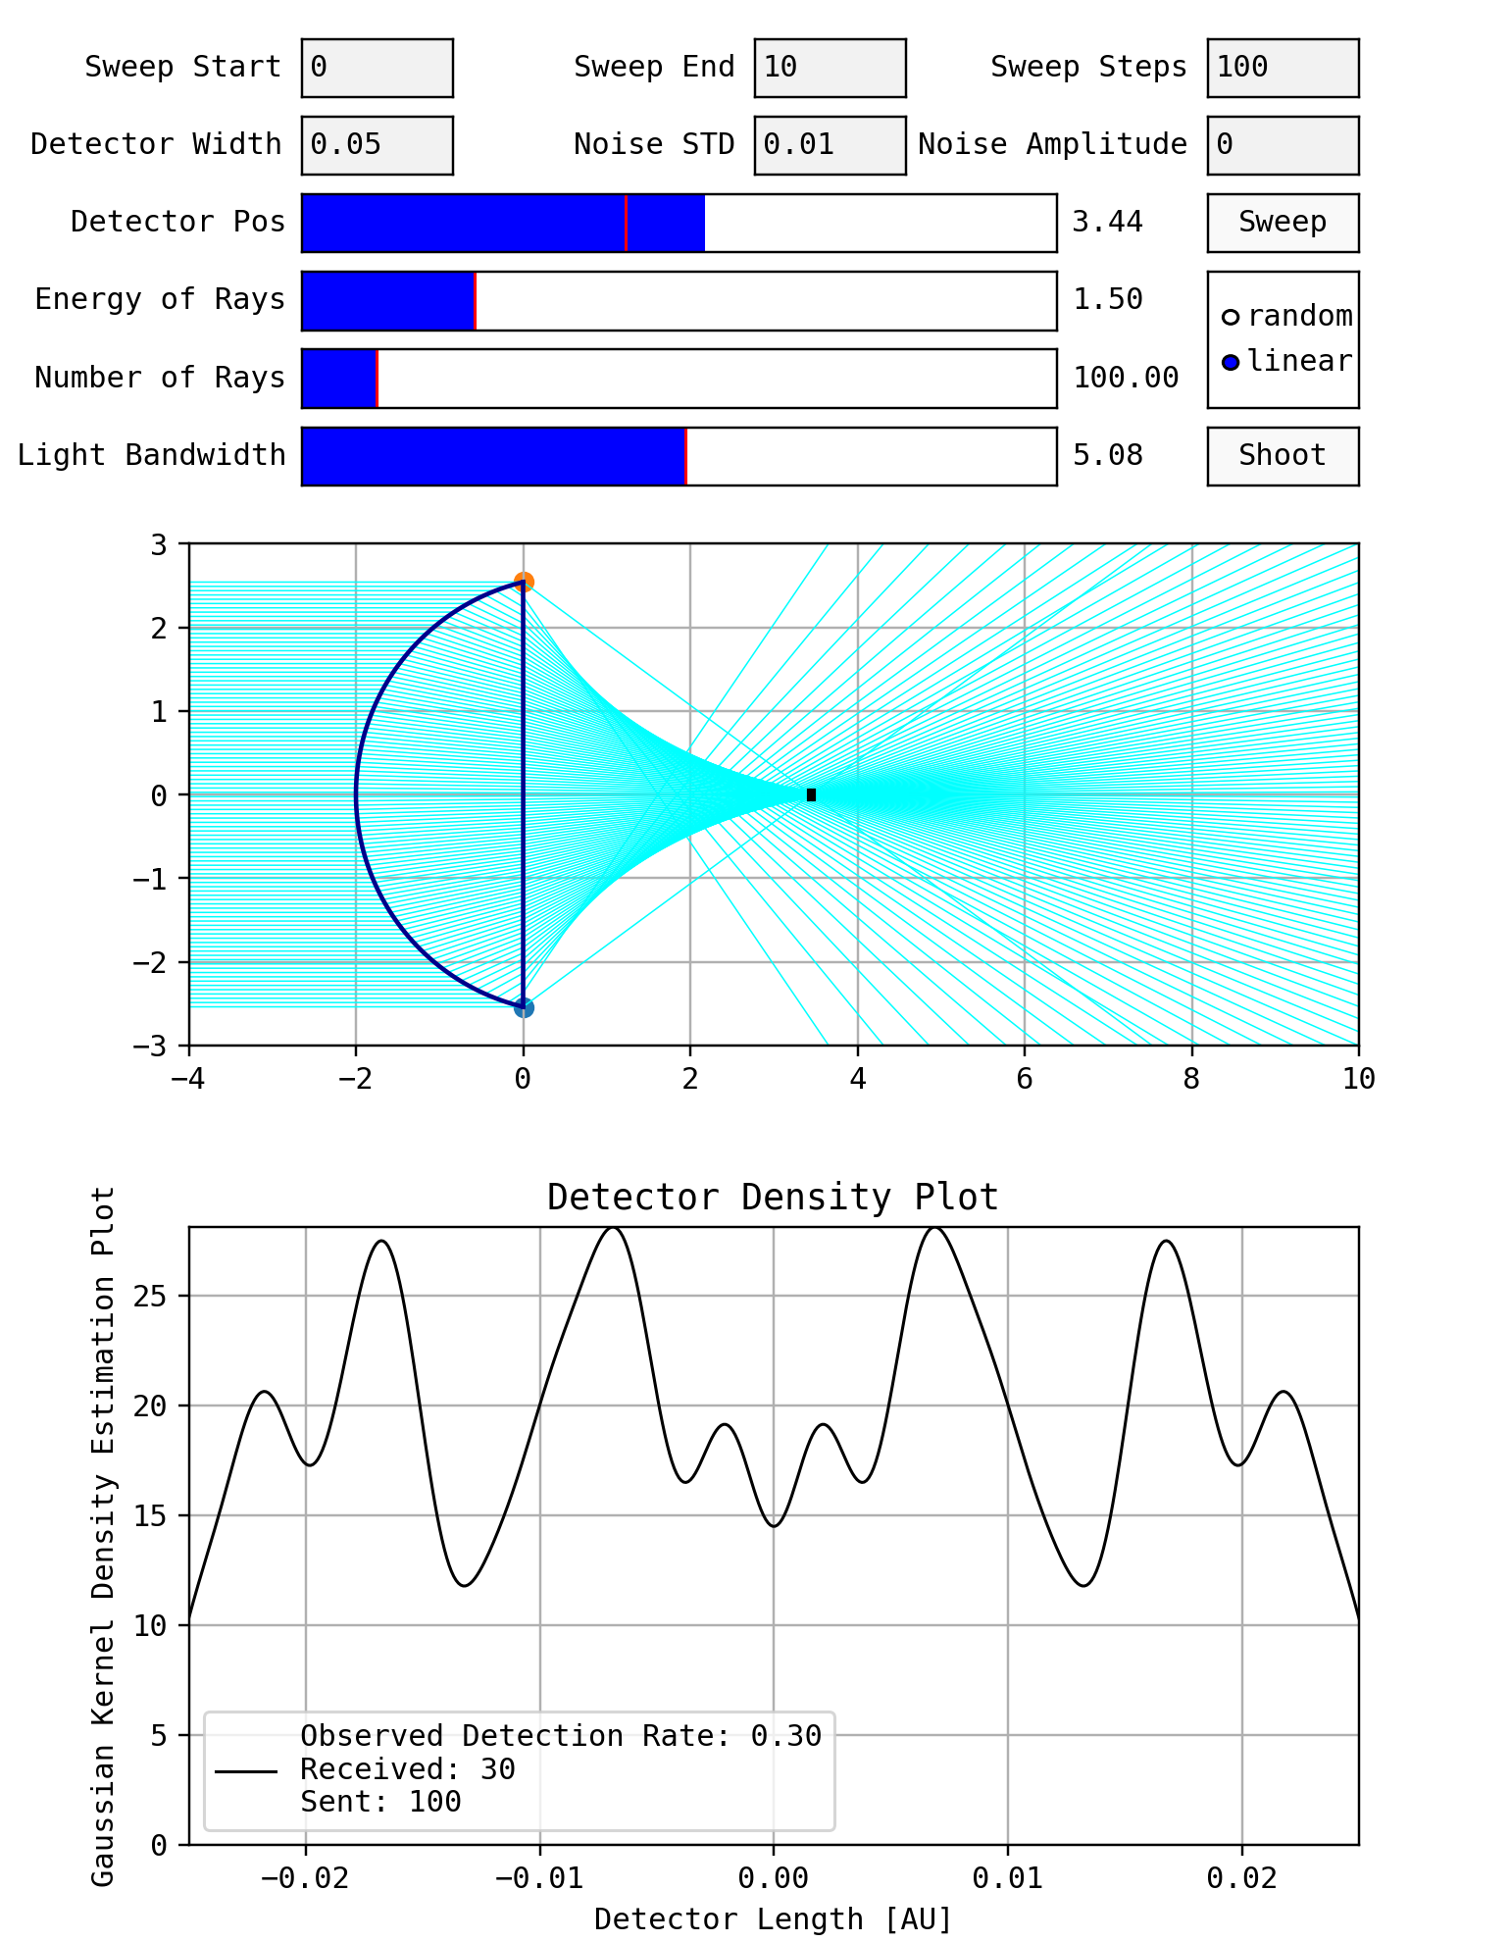
UNOPTIMISED
SPHERICAL ABERRATION
Best form lenses compensate for aberration
RESUTLS
GLOBAL OPTIMIZATION

Slide 11
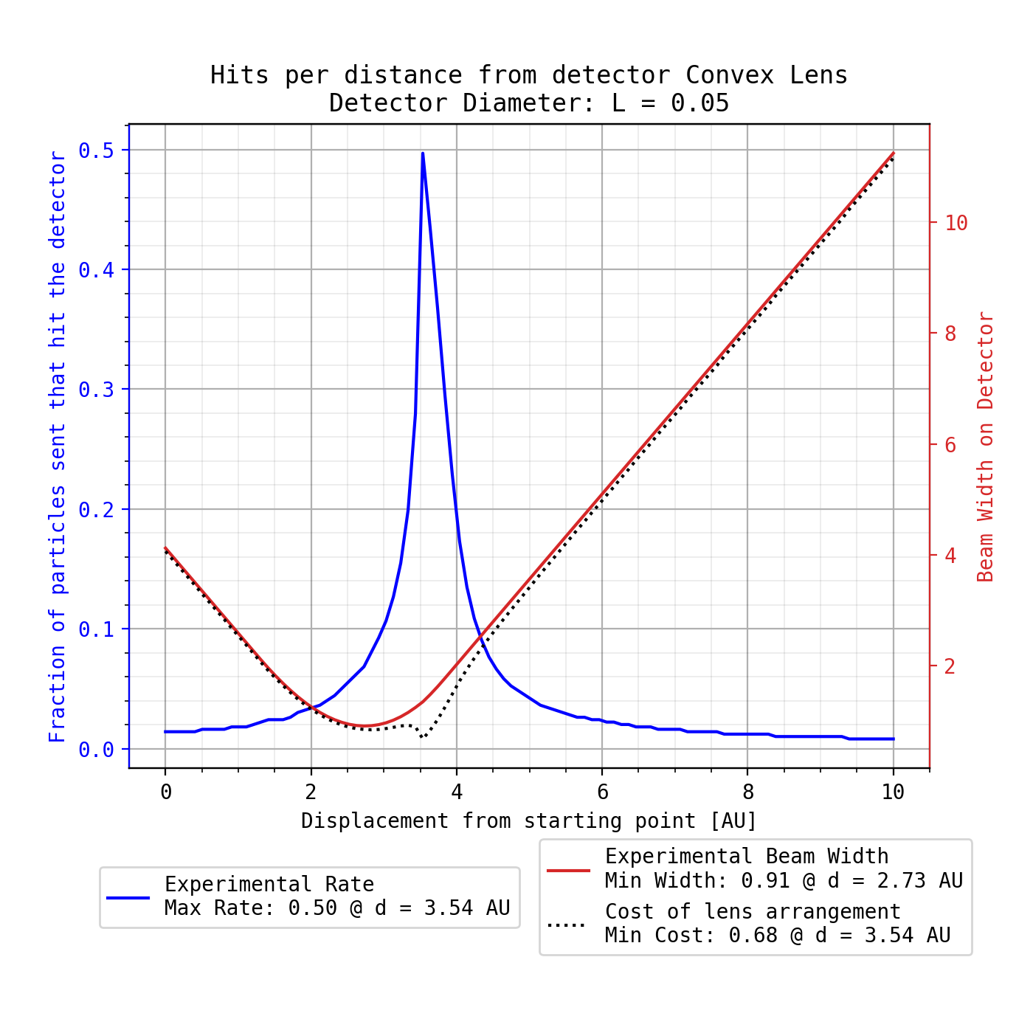
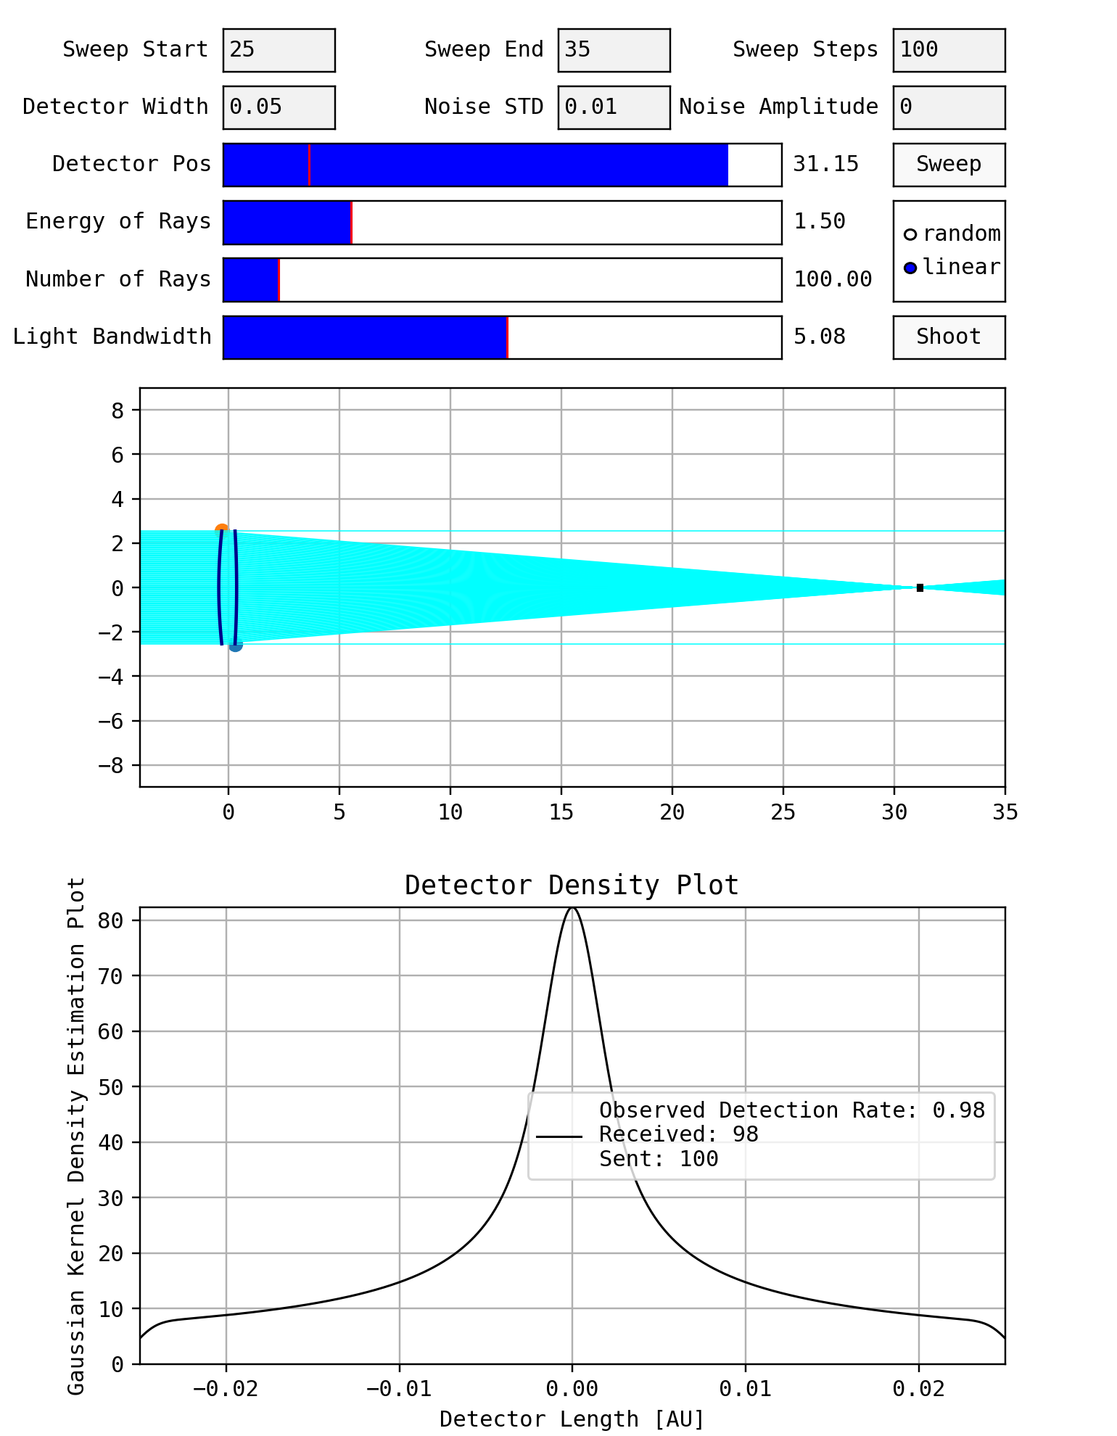
UNOPTIMISED
SPHERICAL ABERRATION
Best form lenses compensate for aberration
RESUTLS
GLOBAL OPTIMIZATION

Slide 12
PARAMETERS
DETECTOR DIAMETER | 0.05 cm
SWEEP RANGE | 2 – 50 cm
LENS HEIGHT | 5.08 cm
RAY ENERGY | 1.5 eV
RAYS SHOT | 1000
EDGE THICKNESS | 0.3 cm
BOUNDS | [-2.54, -0.1] cm [0.1, 2.54] cm
CORES USED | 16
RESULTS
RADIUS 1 | 45.6 cm
RADIUS 2 | 24.2 cm
MAX THICKNESS | 70.1 cm
RESUTLS
GLOBAL OPTIMIZATION

Slide 13
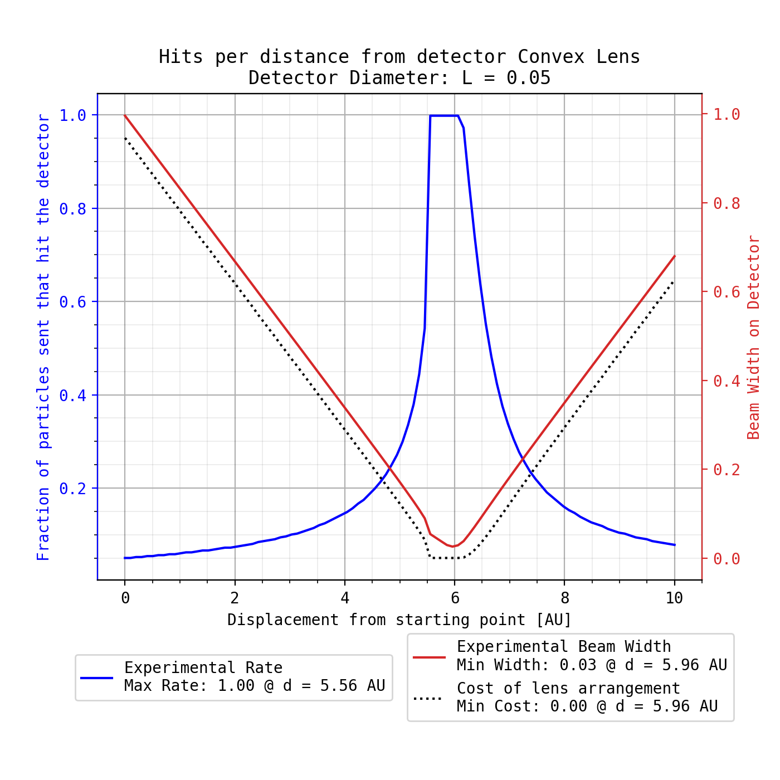
PARAMETERS
DETECTOR DIAMETER | 0.05 cm
SWEEP RANGE | 2 – 50 cm
LENS HEIGHT | 5.08 cm
RAY ENERGY | 1.5 eV
RAYS SHOT | 1000
EDGE THICKNESS | 0.3 cm
BOUNDS | [-2.54, -0.1] cm [0.1, 2.54] cm
CORES USED | 16
RESULTS
RADIUS 1 | 45.6 cm
RADIUS 2 | 24.2 cm
MAX THICKNESS | 70.1 cm
RESUTLS
GLOBAL OPTIMIZATION

Slide 14
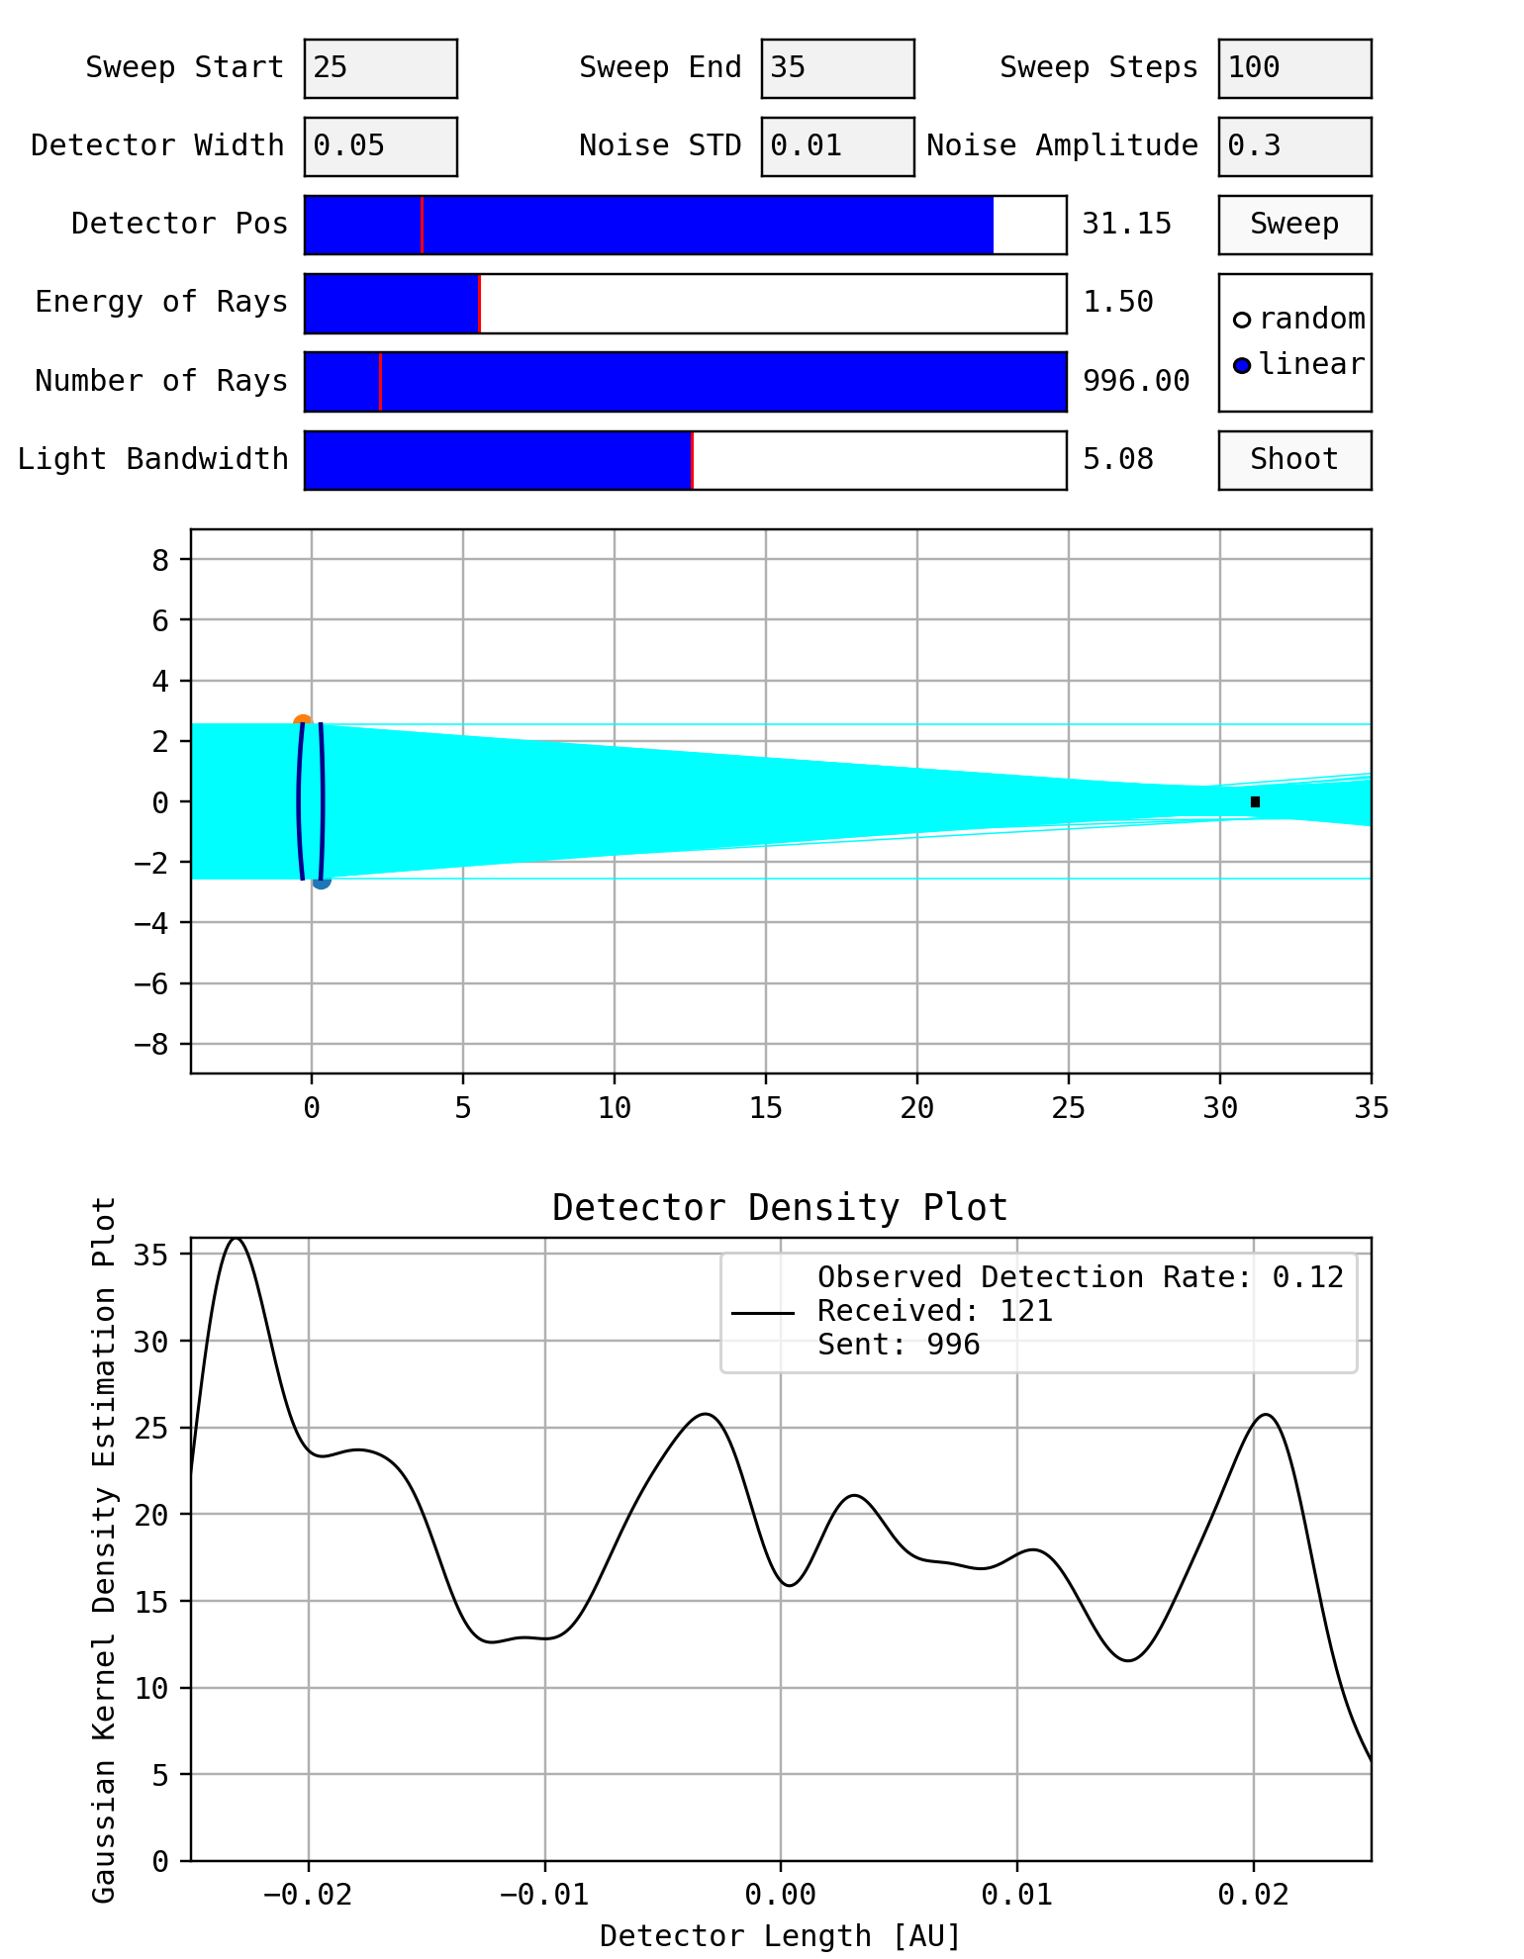
PARAMETERS
DETECTOR DIAMETER | 0.05 cm
SWEEP RANGE | 2 – 50 cm
LENS HEIGHT | 5.08 cm
RAY ENERGY | 1.5 eV
RAYS SHOT | 1000
EDGE THICKNESS | 0.3 cm
BOUNDS | [-2.54, -0.1] cm [0.1, 2.54] cm
CORES USED | 16
RESULTS
RADIUS 1 | 45.6 cm
RADIUS 2 | 24.2 cm
MAX THICKNESS | 70.1 cm
RESUTLS
GLOBAL OPTIMIZATION

Slide 15
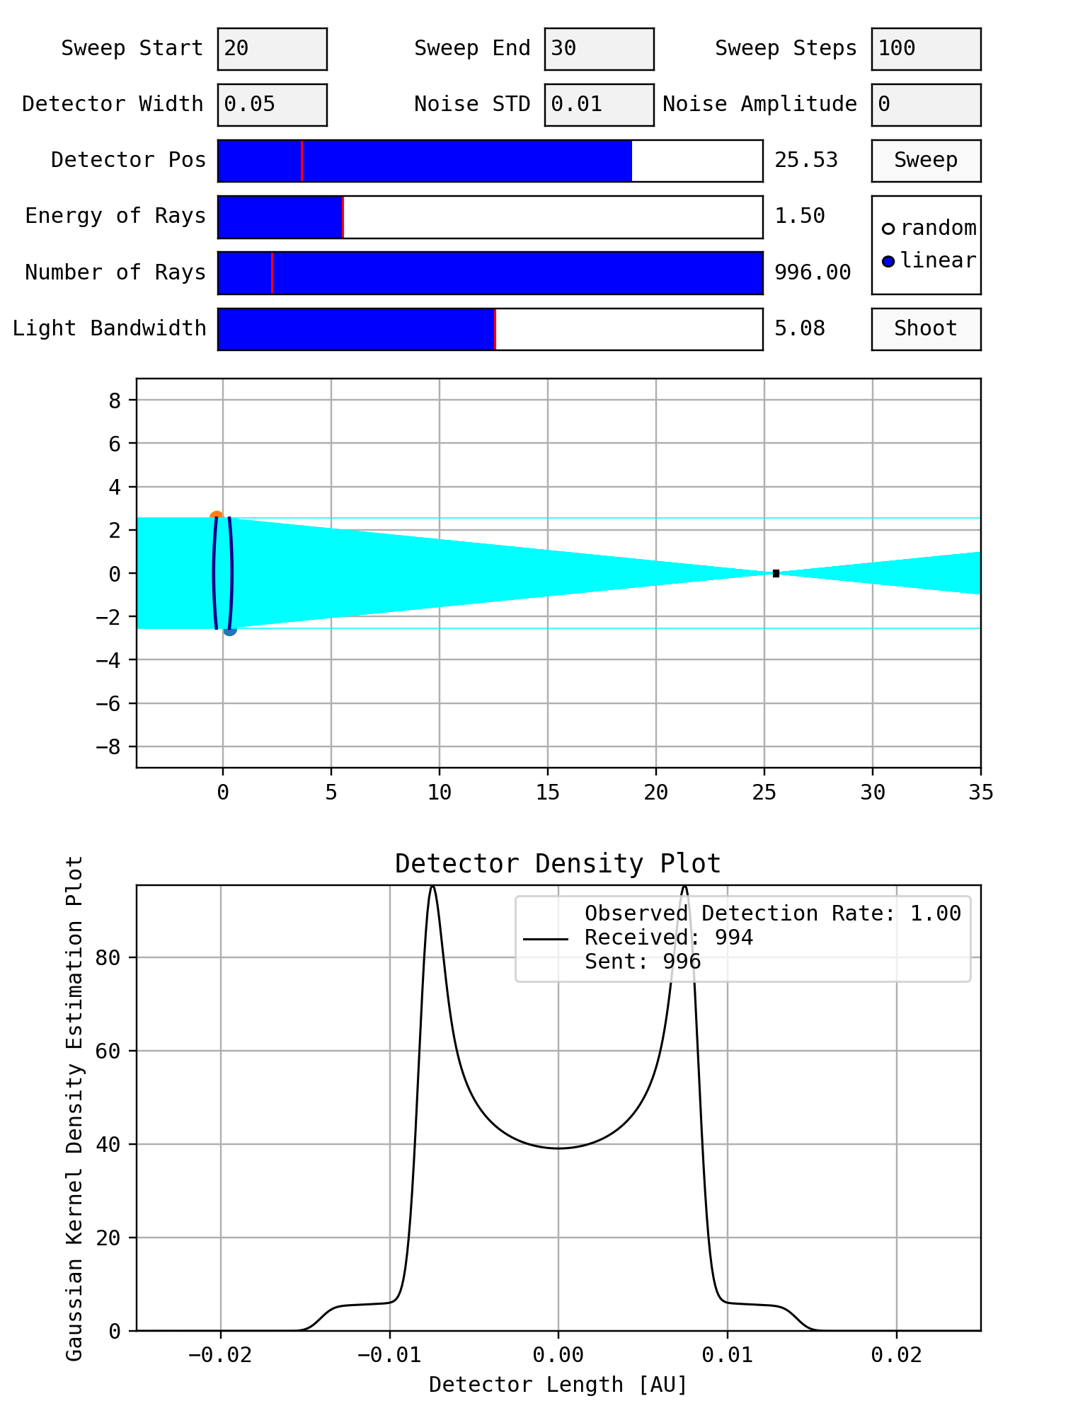
PARAMETERS
DETECTOR DIAMETER | 0.05 cm
SWEEP RANGE | 2 – 50 cm
LENS HEIGHT | 5.08 cm
RAY ENERGY | 1.5 eV
RAYS SHOT | 500
EDGE THICKNESS | 0.3 cm
BOUNDS | [-2.54, -0.1] cm [0.1, 2.54] cm
CORES USED | 16
RESULTS
RADIUS 1 | 26.8 cm
RADIUS 2 | 25.3 cm
MAX THICKNESS | 52.4 cm
RESUTLS
GLOBAL OPTIMIZATION

Slide 16
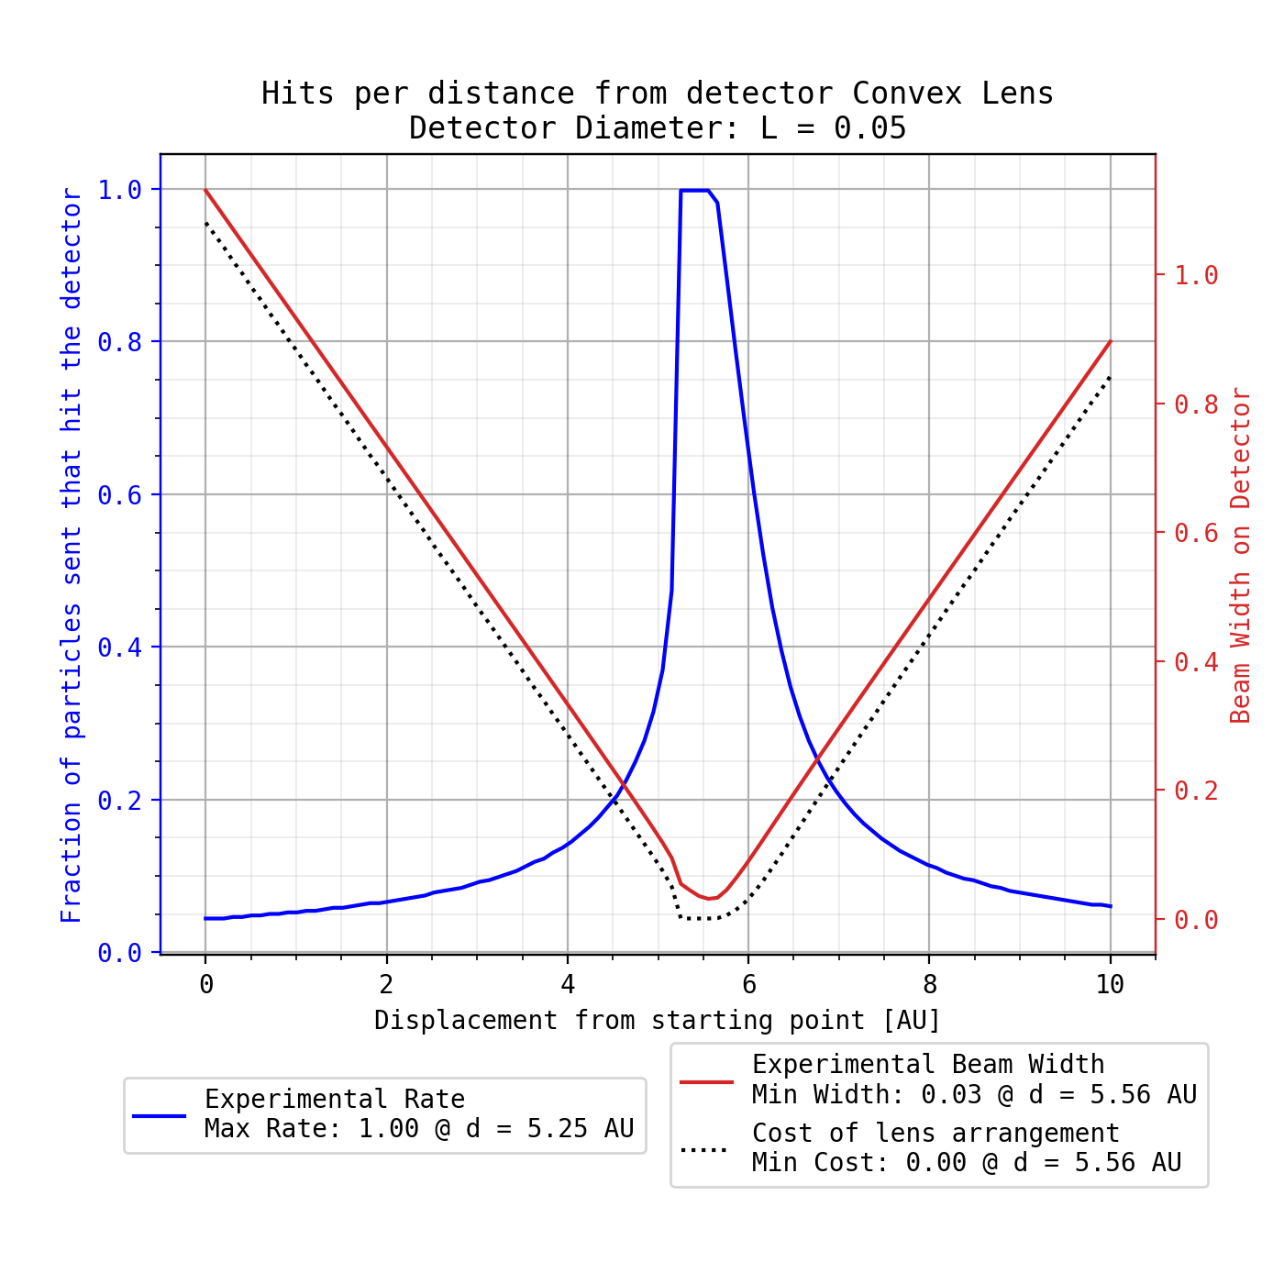
PARAMETERS
DETECTOR DIAMETER | 0.05 cm
SWEEP RANGE | 2 – 50 cm
LENS HEIGHT | 5.08 cm
RAY ENERGY | 1.5 eV
RAYS SHOT | 500
EDGE THICKNESS | 0.3 cm
BOUNDS | [-2.54, -0.1] cm [0.1, 2.54] cm
CORES USED | 16
RESULTS
RADIUS 1 | 26.8 cm
RADIUS 2 | 25.3 cm
MAX THICKNESS | 52.4 cm
RESUTLS
GLOBAL OPTIMIZATION

Slide 17
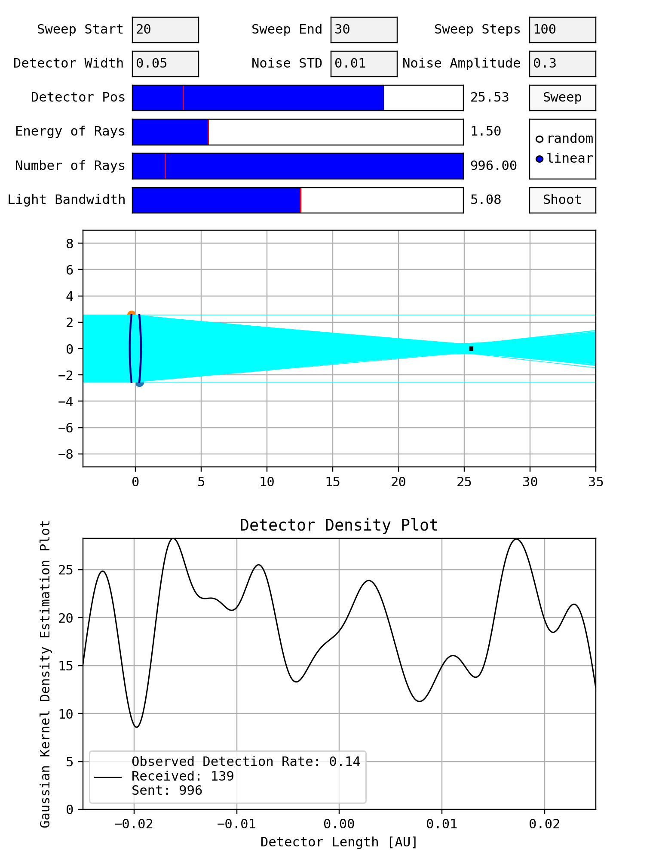
PARAMETERS
DETECTOR DIAMETER | 0.05 cm
SWEEP RANGE | 2 – 50 cm
LENS HEIGHT | 5.08 cm
RAY ENERGY | 1.5 eV
RAYS SHOT | 500
EDGE THICKNESS | 0.3 cm
BOUNDS | [-2.54, -0.1] cm [0.1, 2.54] cm
CORES USED | 16
RESULTS
RADIUS 1 | 26.8 cm
RADIUS 2 | 25.3 cm
MAX THICKNESS | 52.4 cm
RESUTLS
GLOBAL OPTIMIZATION

Slide 18
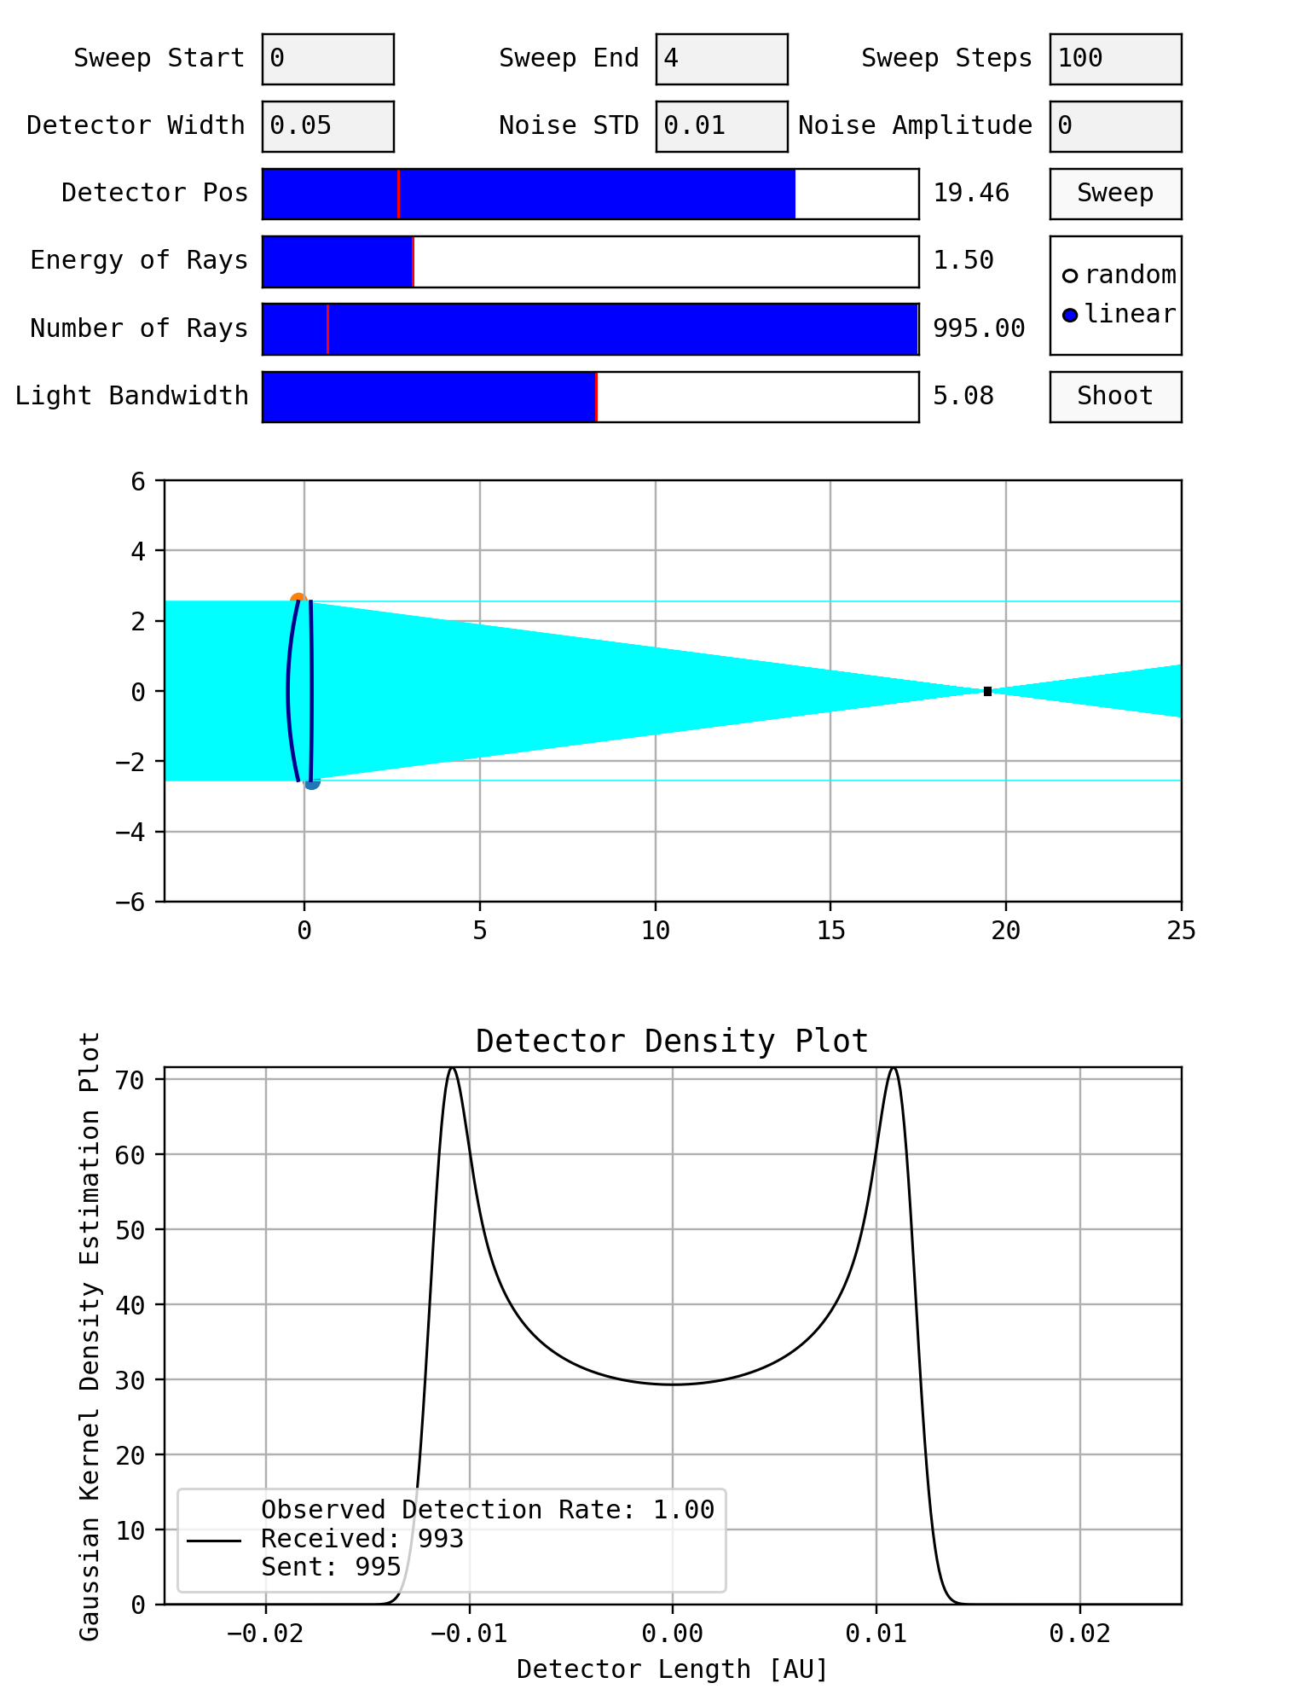
PARAMETERS
DETECTOR DIAMETER | 0.05 cm
SWEEP RANGE | 2 – 50 cm
LENS HEIGHT | 5.08 cm
RAY ENERGY | 1.5 eV
RAYS SHOT | 500
EDGE THICKNESS | 0.18 cm
BOUNDS | [-2.54, -0.1] cm [0.1, 2.54] cm
CORES USED | 16
RESULTS
RADIUS 1 | inf cm
RADIUS 2 | 11.1 cm
MAX THICKNESS | 126 cm
RESUTLS
GLOBAL OPTIMIZATION

Slide 19
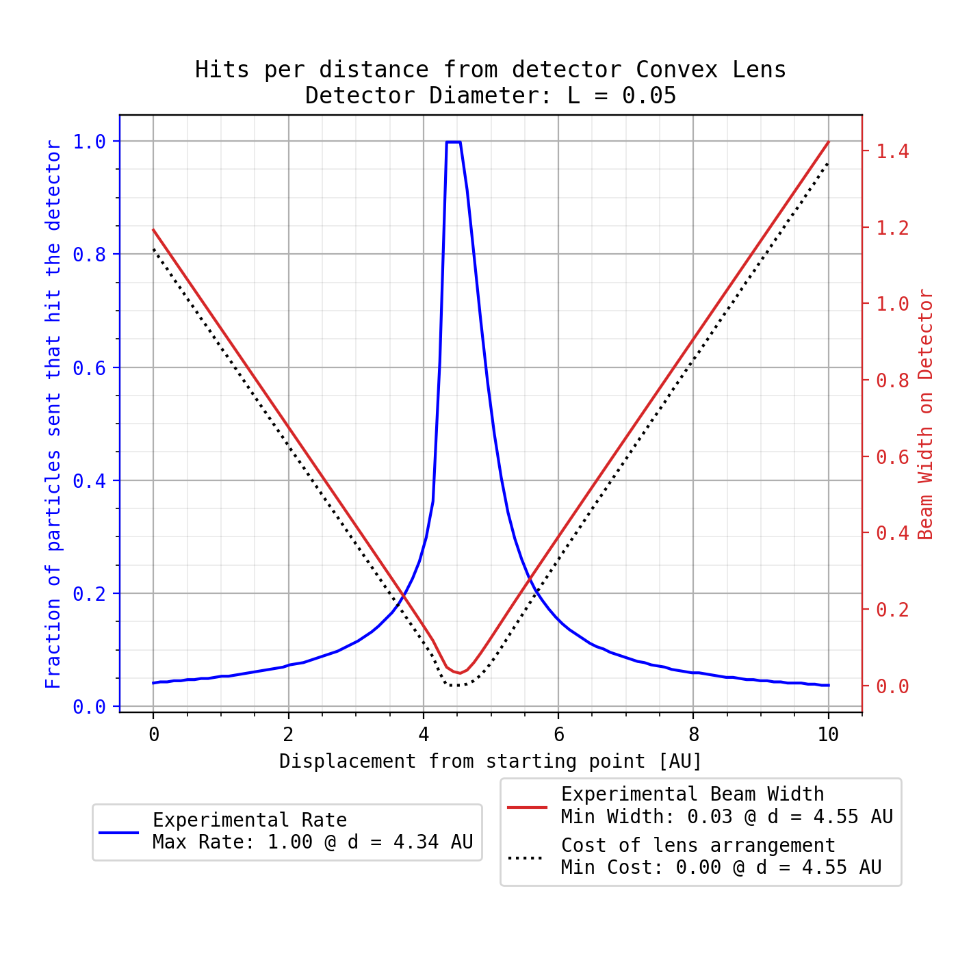
PARAMETERS
DETECTOR DIAMETER | 0.05 cm
SWEEP RANGE | 2 – 50 cm
LENS HEIGHT | 5.08 cm
RAY ENERGY | 1.5 eV
RAYS SHOT | 500
EDGE THICKNESS | 0.18 cm
BOUNDS | [-2.54, -0.1] cm [0.1, 2.54] cm
CORES USED | 16
RESULTS
RADIUS 1 | inf cm
RADIUS 2 | 11.1 cm
MAX THICKNESS | 126 cm
RESUTLS
GLOBAL OPTIMIZATION

Slide 20

PARAMETERS
DETECTOR DIAMETER | 0.05 cm
SWEEP RANGE | 2 – 50 cm
LENS HEIGHT | 5.08 cm
RAY ENERGY | 1.5 eV
RAYS SHOT | 500
EDGE THICKNESS | 0.18 cm
BOUNDS | [-2.54, -0.1] cm [0.1, 2.54] cm
CORES USED | 16
RESULTS
RADIUS 1 | inf cm
RADIUS 2 | 11.1 cm
MAX THICKNESS | 126 cm
RESUTLS
GLOBAL OPTIMIZATION

Slide 21
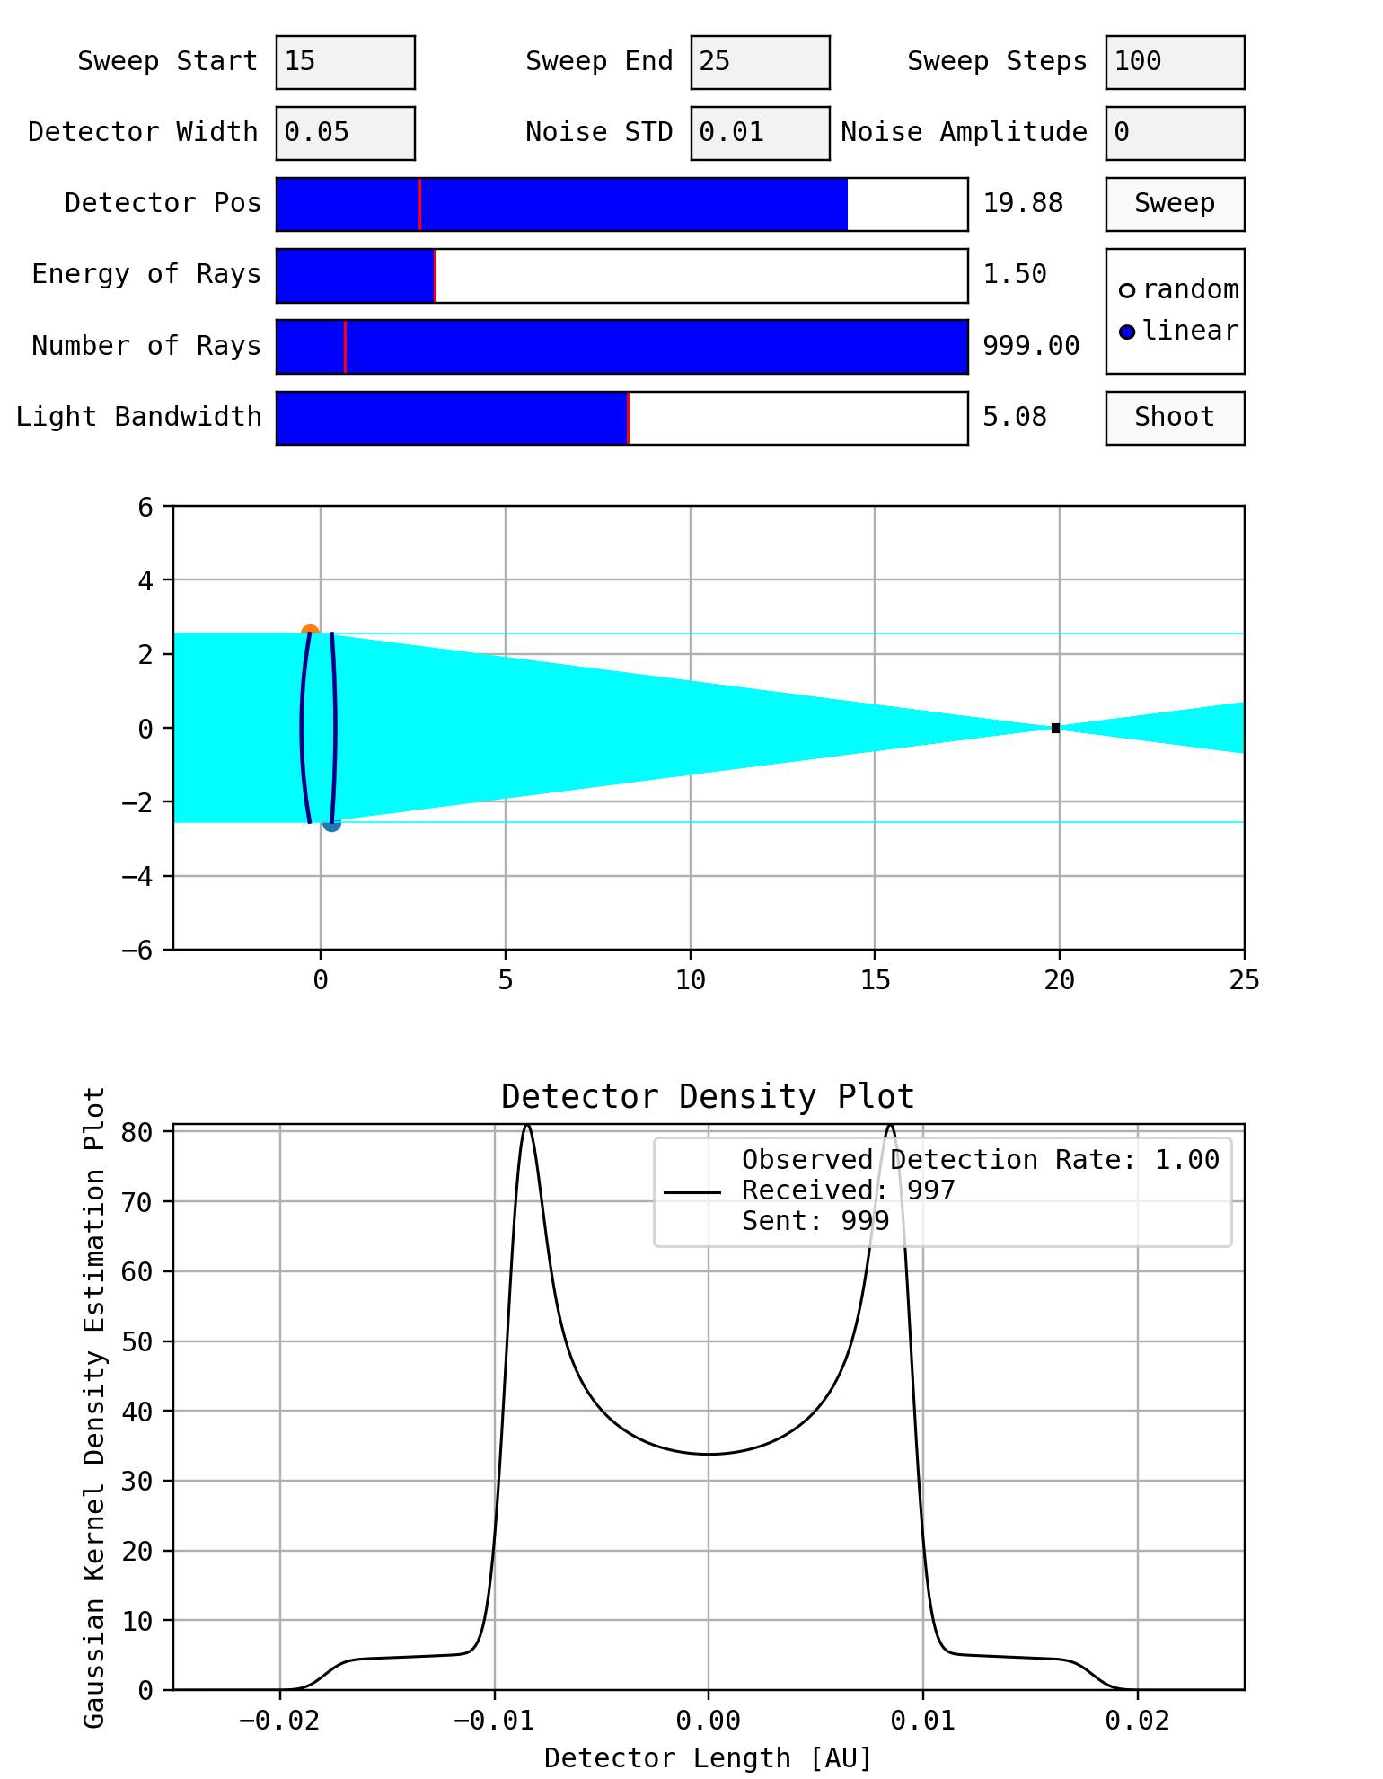
PARAMETERS
DETECTOR DIAMETER | 0.05 cm
SWEEP RANGE | 10 – 20 cm
LENS HEIGHT | 5.08 cm
RAY ENERGY | 1.5 eV
RAYS SHOT | 500
EDGE THICKNESS | 0.30 cm
BOUNDS | [-2.54, -0.1] cm [0.1, 2.54] cm
CORES USED | 4
RESULTS
RADIUS 1 | 33.7 cm
RADIUS 2 | 14.6 cm
MAX THICKNESS | 48.1 cm
RESUTLS
GLOBAL OPTIMIZATION

Slide 22
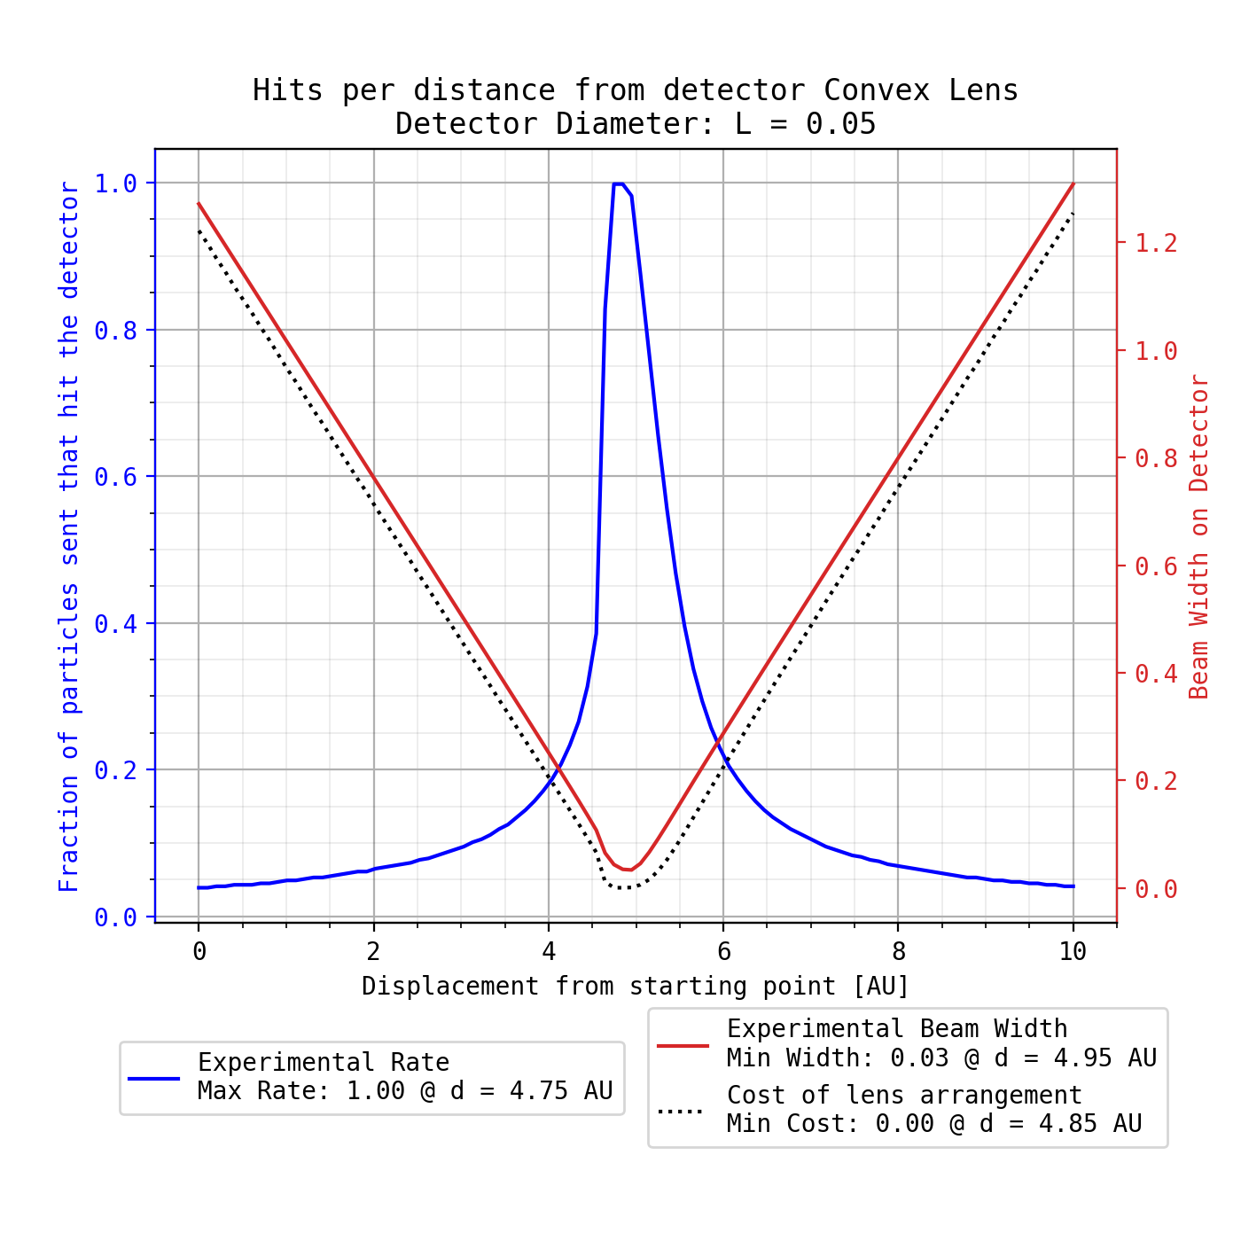
PARAMETERS
DETECTOR DIAMETER | 0.05 cm
SWEEP RANGE | 10 – 20 cm
LENS HEIGHT | 5.08 cm
RAY ENERGY | 1.5 eV
RAYS SHOT | 500
EDGE THICKNESS | 0.30 cm
BOUNDS | [-2.54, -0.1] cm [0.1, 2.54] cm
CORES USED | 4
RESULTS
RADIUS 1 | 33.7 cm
RADIUS 2 | 14.6 cm
MAX THICKNESS | 48.1 cm
RESUTLS
GLOBAL OPTIMIZATION

Slide 23

PARAMETERS
DETECTOR DIAMETER | 0.05 cm
SWEEP RANGE | 10 – 20 cm
LENS HEIGHT | 5.08 cm
RAY ENERGY | 1.5 eV
RAYS SHOT | 500
EDGE THICKNESS | 0.30 cm
BOUNDS | [-2.54, -0.1] cm [0.1, 2.54] cm
CORES USED | 4
RESULTS
RADIUS 1 | 33.7 cm
RADIUS 2 | 14.6 cm
MAX THICKNESS | 48.1 cm
RESUTLS
GLOBAL OPTIMIZATION

Slide 24
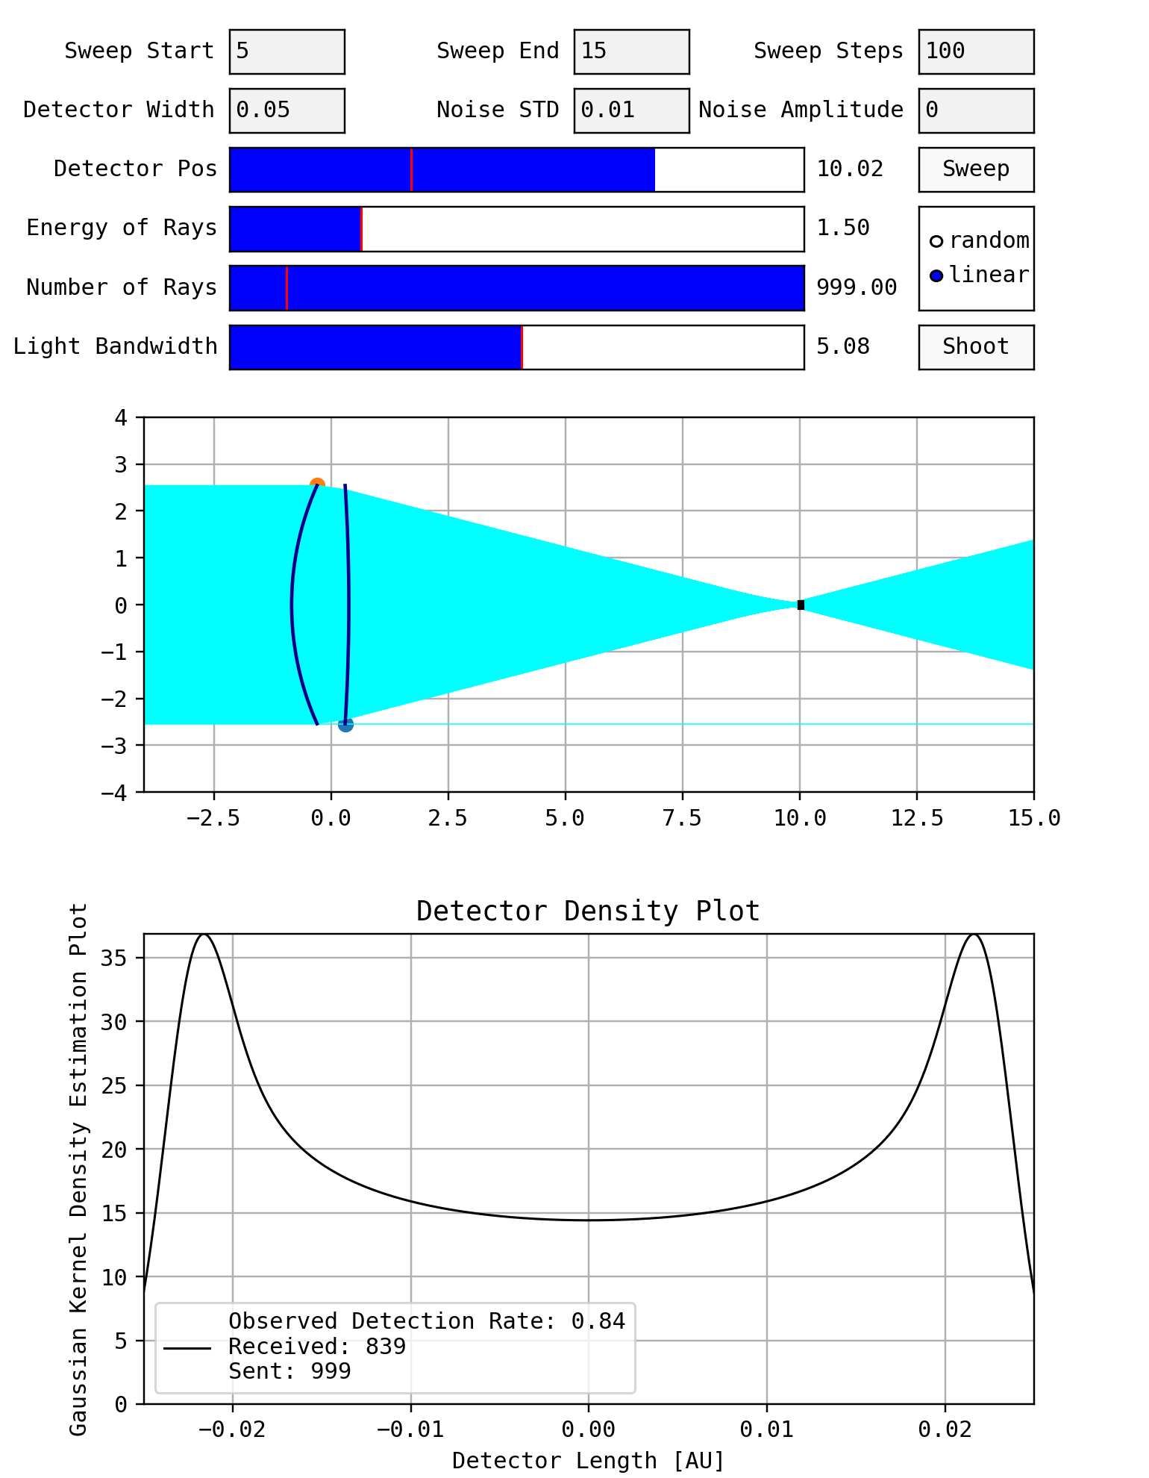
PARAMETERS
DETECTOR DIAMETER | 0.05 cm
SWEEP RANGE | 5 – 10 cm
LENS HEIGHT | 5.08 cm
RAY ENERGY | 1.5 eV
RAYS SHOT | 1000
EDGE THICKNESS | 0.30 cm
BOUNDS | [-2.54, -0.1] cm [0.1, 2.54] cm
CORES USED | 16
RESULTS
RADIUS 1 | 41.1 cm
RADIUS 2 | 6.22 cm
MAX THICKNESS | 47.7 cm
RESUTLS
GLOBAL OPTIMIZATION

Slide 25
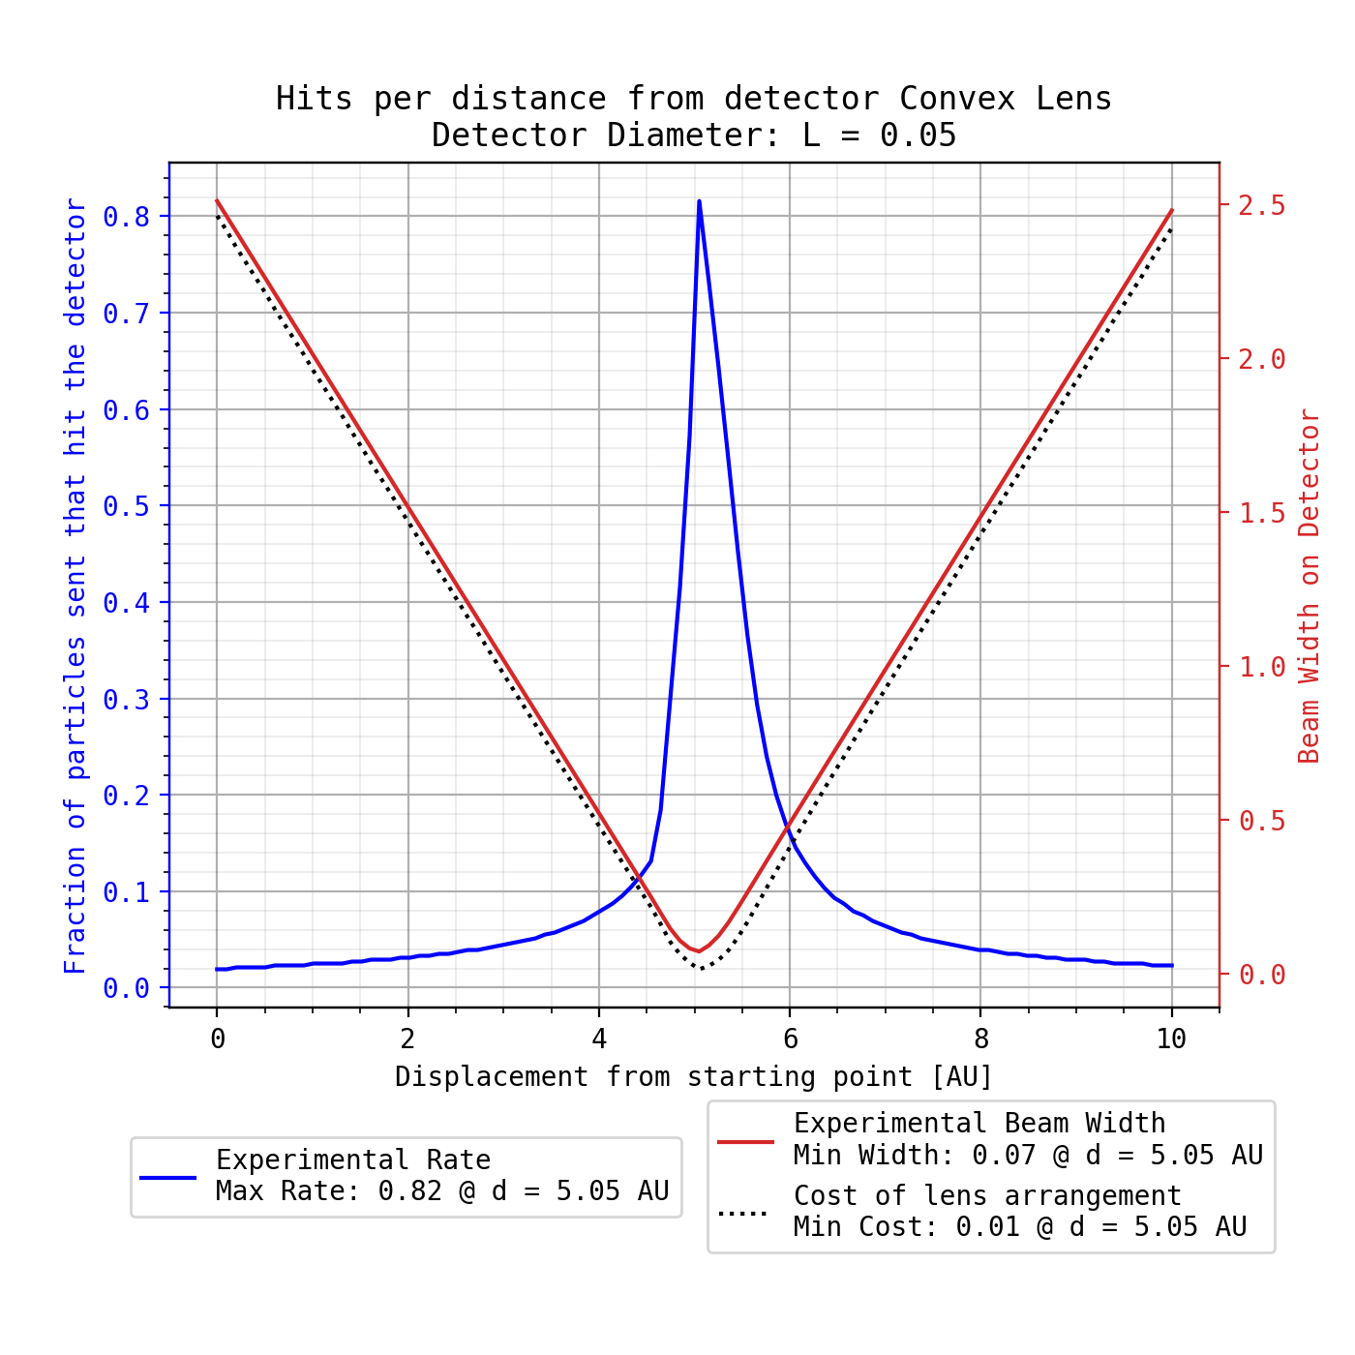
PARAMETERS
DETECTOR DIAMETER | 0.05 cm
SWEEP RANGE | 5 – 10 cm
LENS HEIGHT | 5.08 cm
RAY ENERGY | 1.5 eV
RAYS SHOT | 1000
EDGE THICKNESS | 0.30 cm
BOUNDS | [-2.54, -0.1] cm [0.1, 2.54] cm
CORES USED | 16
RESULTS
RADIUS 1 | 41.1 cm
RADIUS 2 | 6.22 cm
MAX THICKNESS | 47.7 cm
RESUTLS
GLOBAL OPTIMIZATION

Slide 26
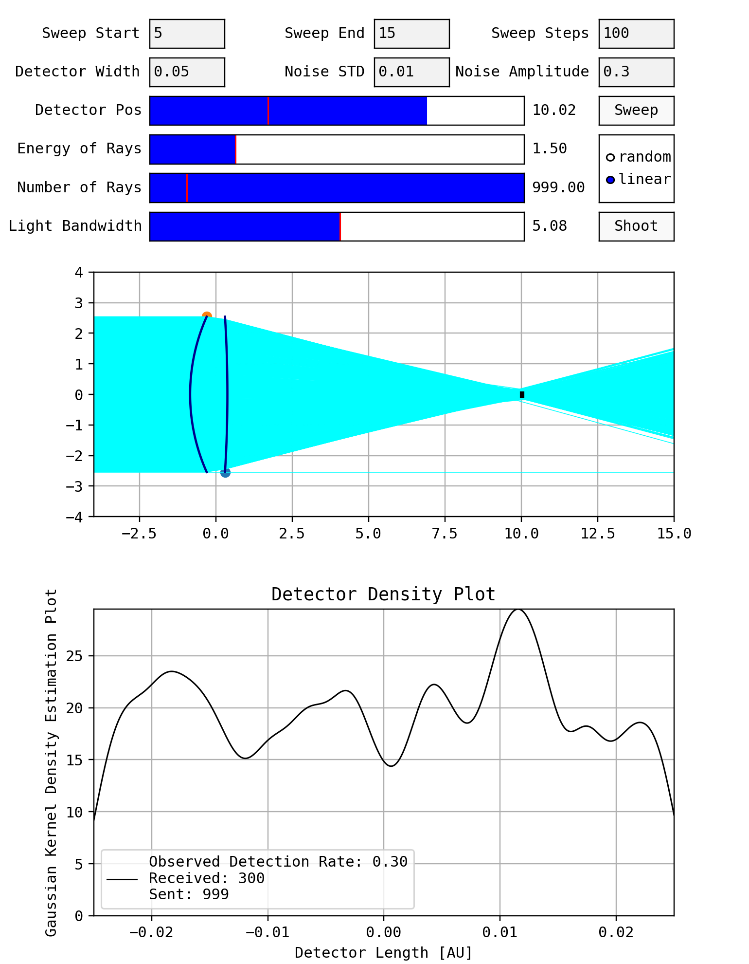
PARAMETERS
DETECTOR DIAMETER | 0.05 cm
SWEEP RANGE | 5 – 10 cm
LENS HEIGHT | 5.08 cm
RAY ENERGY | 1.5 eV
RAYS SHOT | 1000
EDGE THICKNESS | 0.30 cm
BOUNDS | [-2.54, -0.1] cm [0.1, 2.54] cm
CORES USED | 16
RESULTS
RADIUS 1 | 41.1 cm
RADIUS 2 | 6.22 cm
MAX THICKNESS | 47.7 cm
RESUTLS
GLOBAL OPTIMIZATION

Slide 27
CONCLUSIONS
ABERRATION COMPENSATION

Slide 28
BEST FORM LENSES
ABBERATION COMPENSATION PLATES
ASPHERICAL LENSES
THORLABS https://www.thorlabs.com/navigation.cfm?guide_id=2272
ASPHERIC LENSES https://www.thorlabs.com/newgrouppage9.cfm?objectgroup_id=10649
EDMUND https://www.edmundoptics.com/knowledge-center/application-notes/optics/an-in-depth-look-at-spherical-aberration-compensation-plates/
WIKIMAGIK https://en.wikipedia.org/wiki/Spherical_aberration
CONCLUSIONS
ABERRATION COMPENSATION

